Slide 1
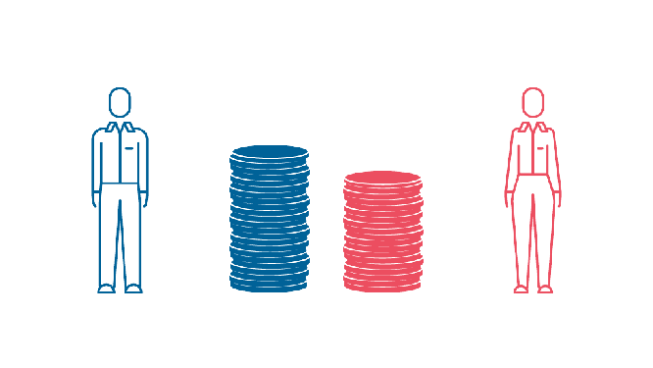

GENDER PAY GAP
Data Mining - Practical Work 1
Alessandro Scannavini
Miguel Gutiérrez
Joan Areal
Fujie Mei
Laia Bonilla

Slide 2
INDEX
DESCRIPTIVE ANALYSIS & PREPROCESSING
CLUSTERING
DATA MINING PROCESS
PROFILING
TOPICS ADDRESSED, GOALS AND URLS
PCA
CONCLUSIONS
1
2
3
4
5
6
7

Slide 3



TOPICS ADDRESSED, GOALS AND URLS
Determine whether there is a significant gender pay gap
Factors that may influence pay gap
Gender Pay Gap Dataset | Kaggle
1940CensusDASTestData

Slide 4
DATA MINING PROCESS
Data collection
Data
selection
Data cleaning and preprocessing
Clustering and PCA
Data interpretation and profiling

Slide 5

DATA MINING PROCESS
Data collection
Data
selection
Data cleaning and preprocessing
Clustering and PCA
Data interpretation and profiling

Slide 6
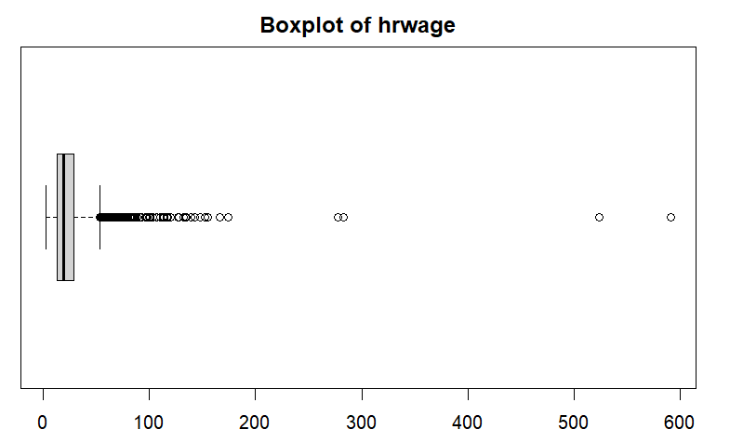

DESCRIPTIVE ANALYSIS
Numerical variables

Slide 7
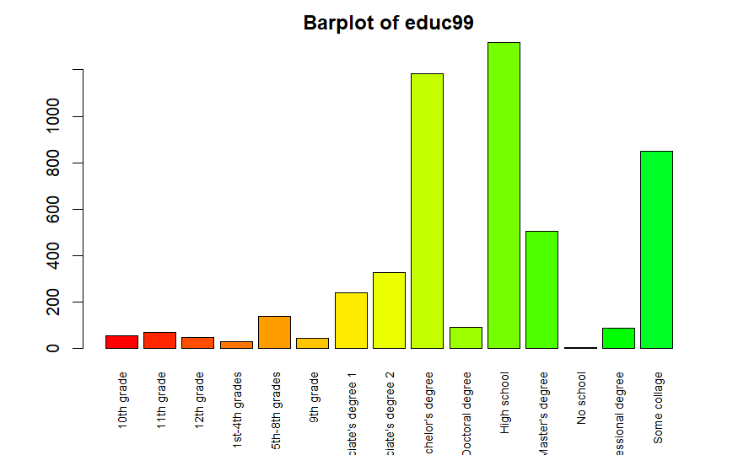
DESCRIPTIVE ANALYSIS
Categorical variables

Slide 8
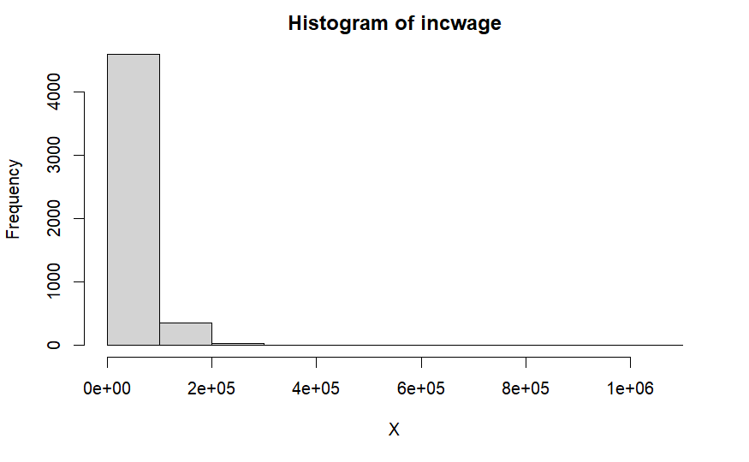
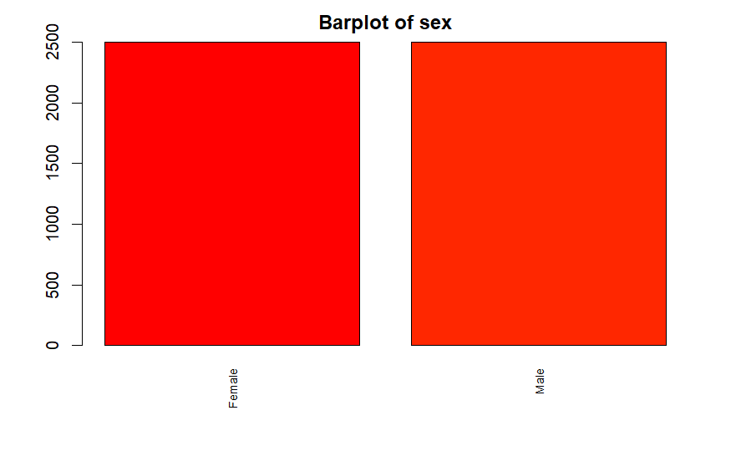
UNIVARIATE DESCRIPTIVE ANALYSIS
Numerical
Categorical & binary

Slide 9
PREPROCESSING
Data collection
Data
selection
Data cleaning and preprocessing
Data analysis
Data transformation
Missing values imputations

Slide 10
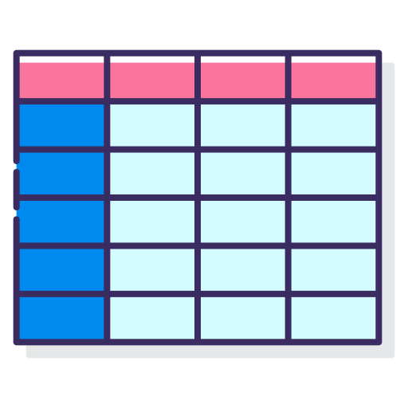

Data transformation
243
21
344287
5000

Slide 11
Missing values imputations
Variable | Missing % respect the variable | Type
Birthplace | 0,76 | Categorical
Metropolitan | 0,06 | Categorical
Occupation of the individual | 41,56 | Categorical
New value
United States
In metro area, outside central
Office and administrative support
KNN

Slide 12
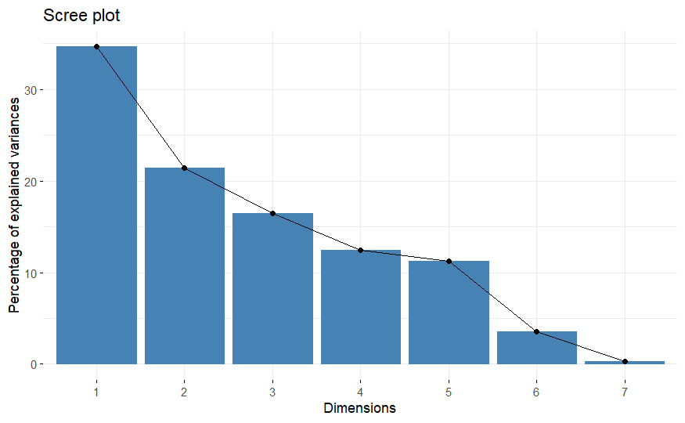
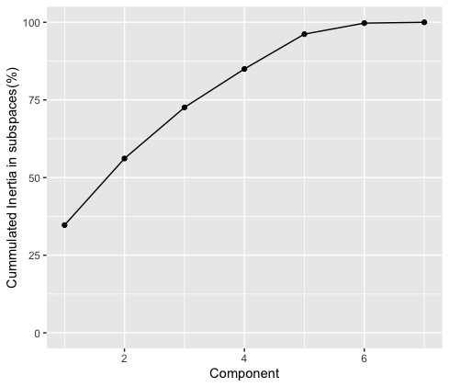
PCA
Scree plot Accumulated inertia
84.98%
72.58%

Slide 13
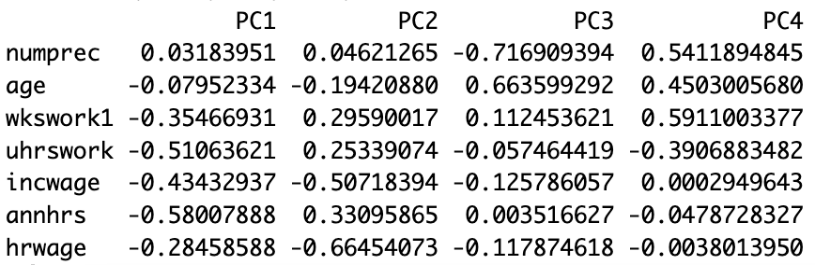
PCA
Principal component values

Slide 14
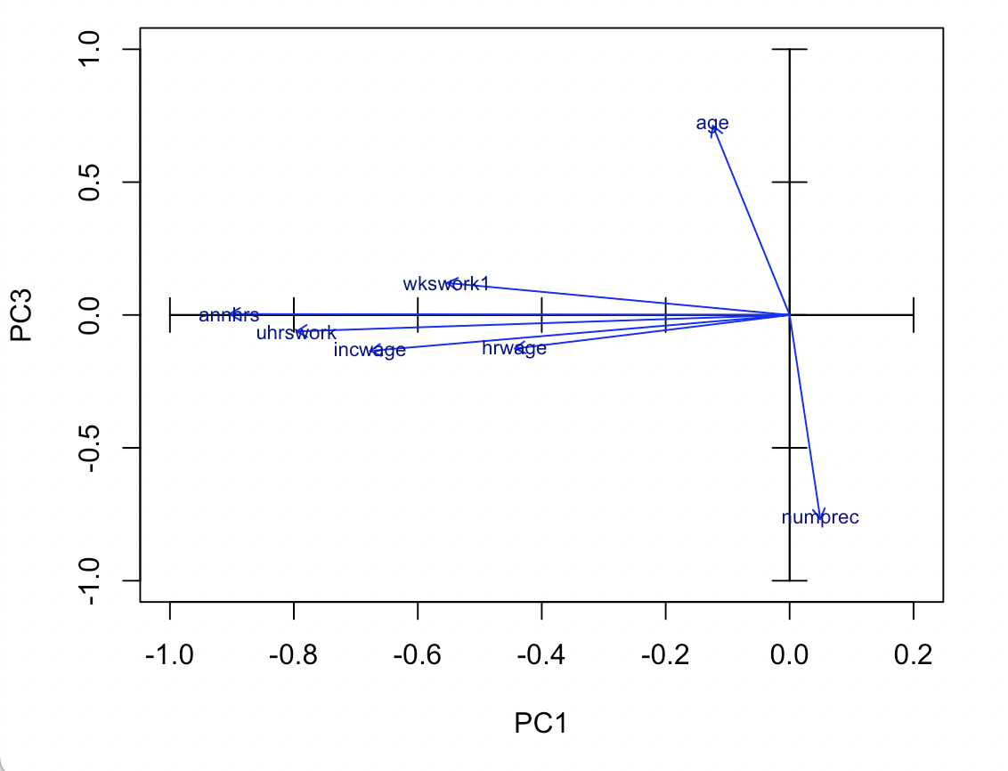
PCA
Numerical variables projection

Slide 15
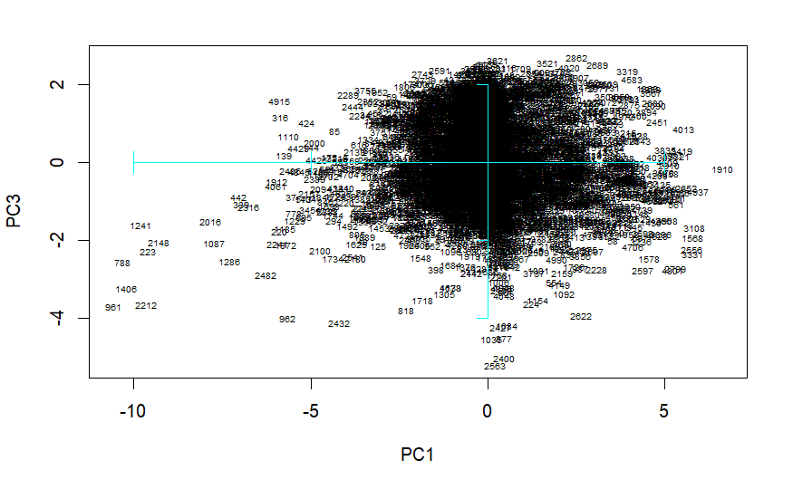
PCA
Individual’s plot

Slide 16
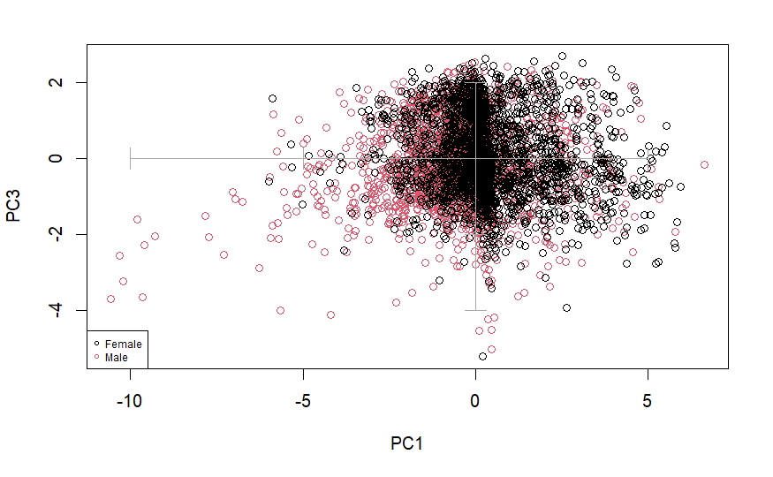
PCA
Qualitative variables - Sex

Slide 17
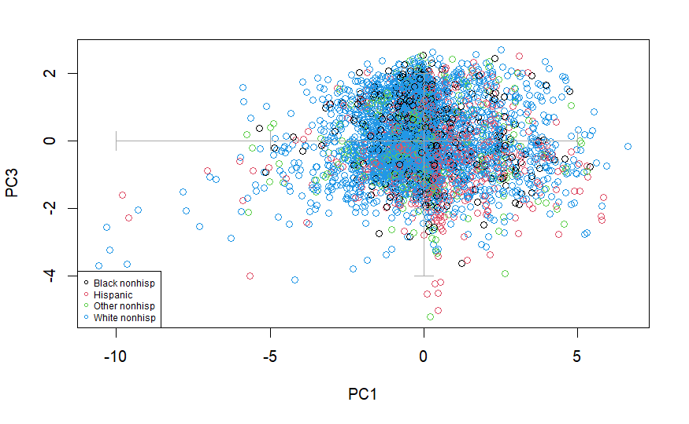
PCA
Qualitative variables - Race

Slide 18
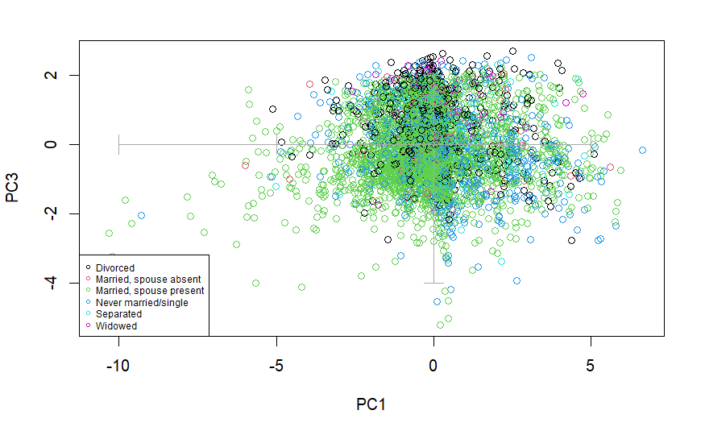
PCA
Qualitative variables - Marst

Slide 19
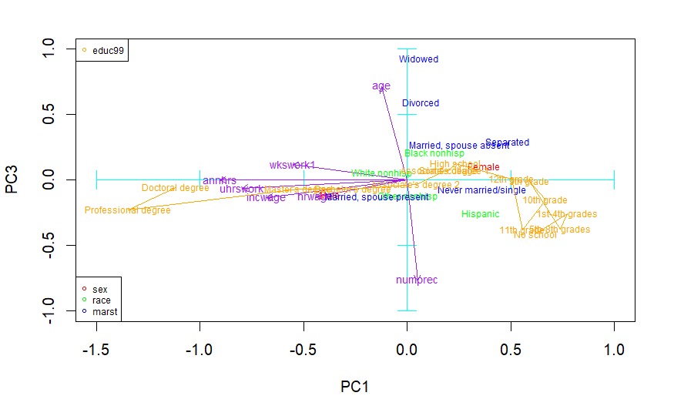
PCA
Numeric and qualitative variables

Slide 20

PCA CONCLUSIONS
Axis interpretation:
PC1 axis: working time and amount of money generated
PC3 axis: age and amount of people that lives together
What can we explain thanks to the axis?
People with a high degree earn more money
The characteristics male, white and married earn more money

Slide 21
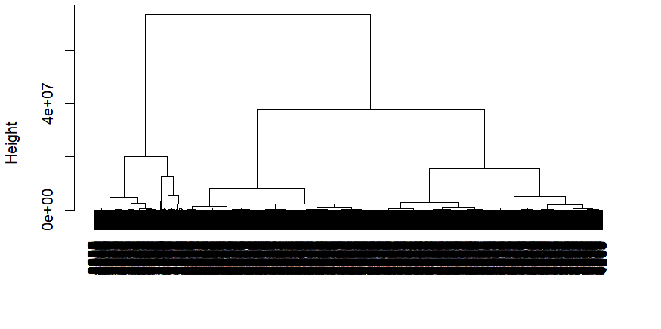
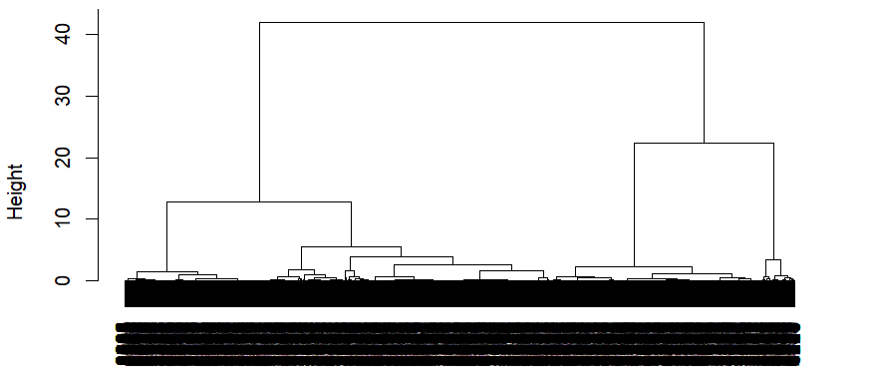
CLUSTERING
Cluster dendrogram DissimMatrix
hclust using ward.D as method
Using gower as metric

Slide 22
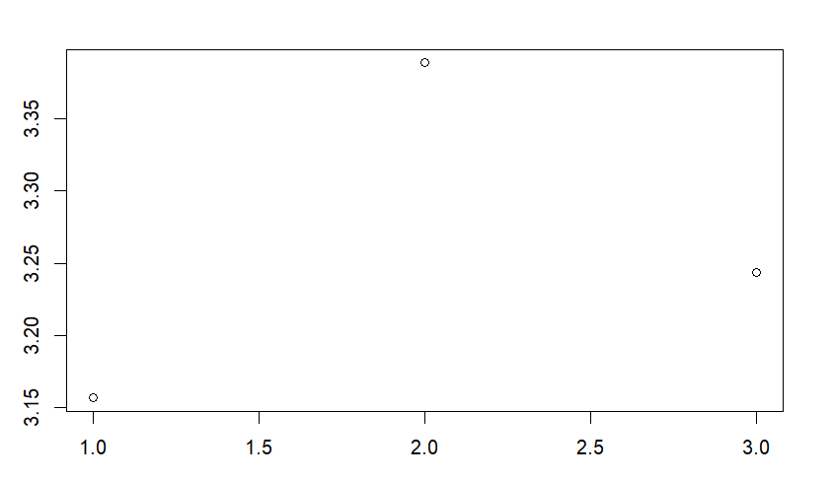
CLUSTERING
Kmeans centroid’s

Slide 23
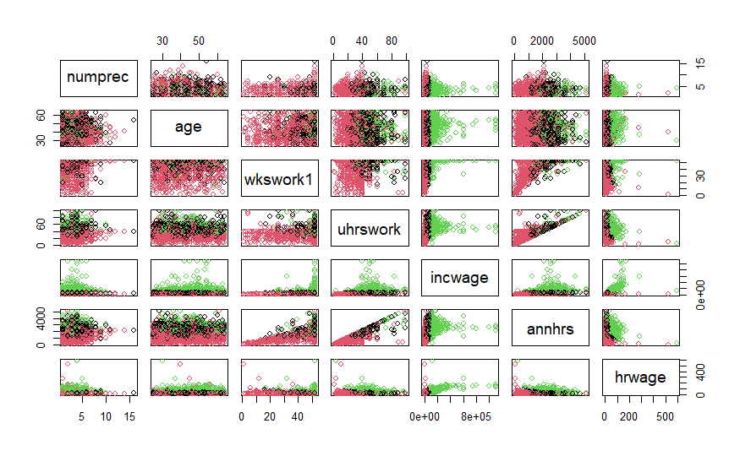
CLUSTERING
Partition visualizer

Slide 24
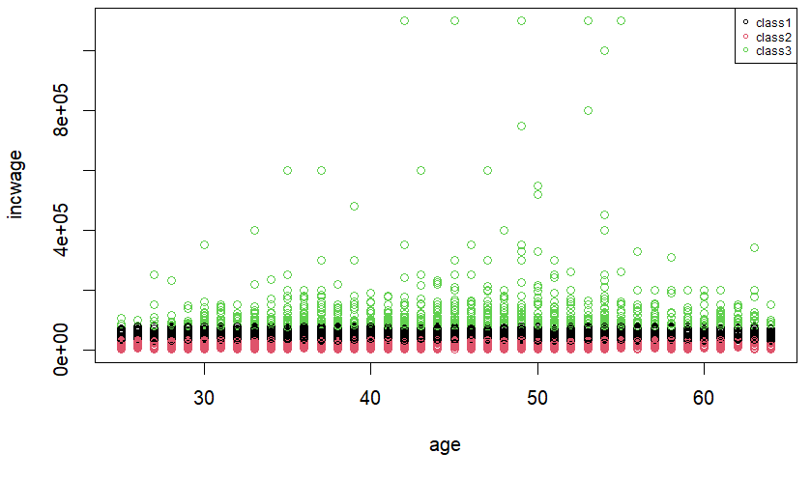
CLUSTERING
Incwage - age

Slide 25
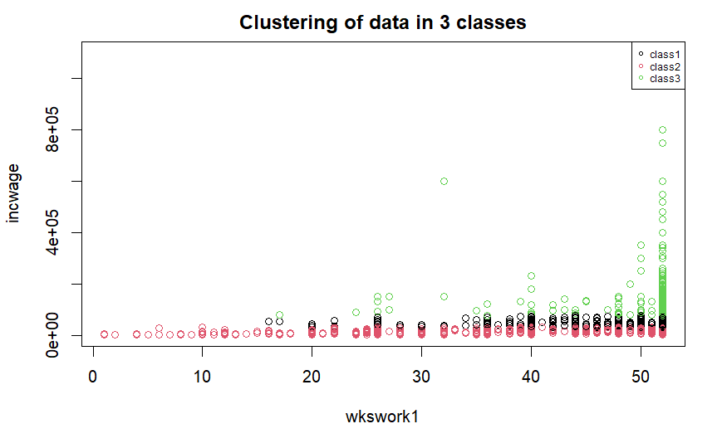
CLUSTERING
Incwage - wkswork1

Slide 26
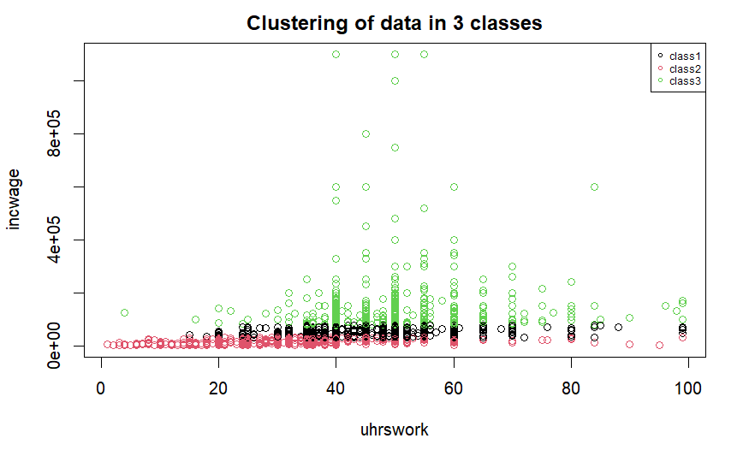
CLUSTERING
Incwage - uhrswork

Slide 27
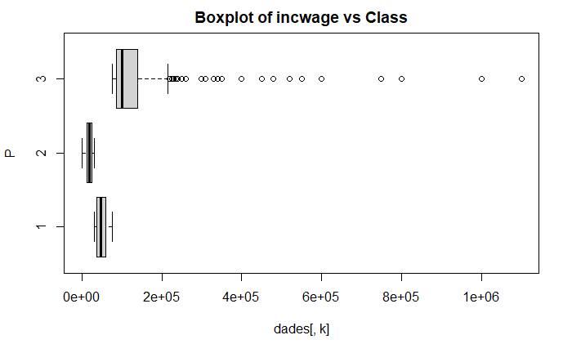
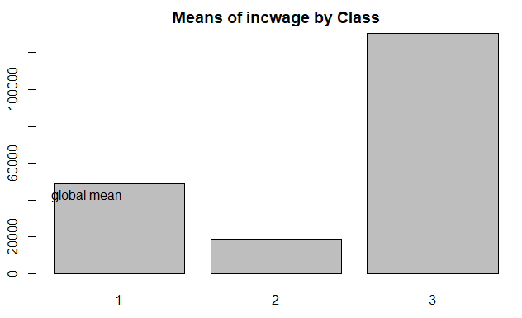
PROFILING
Income
Notes:
As my teammates explained before, we obtained three different clusters after the clustering. To understand our clusters better and see if there are any patterns we can recognize, we performed profiling. we chose some of the plots we found more relevant to showcase them here, these are the plots we got from the variable of incwage, as we can see, cluster two is the one with the lowest mean,cluster three the one with the highest, and cluster one is in between, with its mean very close to the global one. Cluster three has many outliers which could be one of the reasons why its mean is so high, but still, the rest of its values are still higher than the ones from the rest of clusters

Slide 28
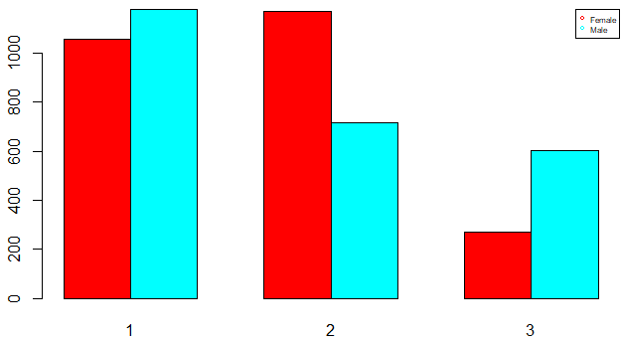
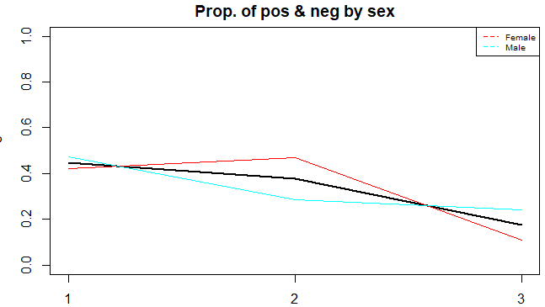
PROFILING
Gender
Notes:
these are the plots from the gender variable, as we can see cluster two is the one with the highest percentage of females, it’s the only one with more females than males. cluster three has the highest percentage of males, with more than double males than females. cluster one again, is kind of in between.

Slide 29
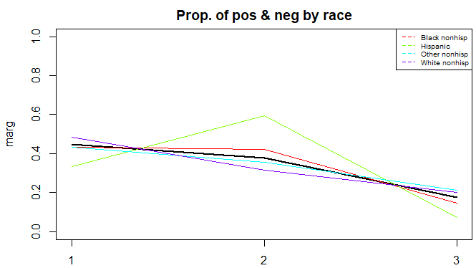
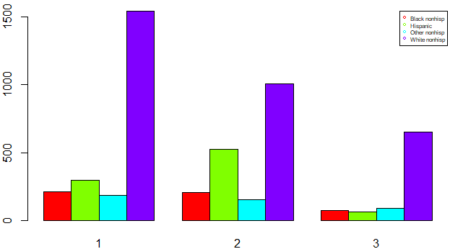
PROFILING
Race
Notes:
these are the plots for race. for race the clusters are not so different from each other, but still we can clearly see that cluster two has the highest percentage of hispanic individuals while cluster three has the lowest. also cluster three has the highest percentage of others.

Slide 30
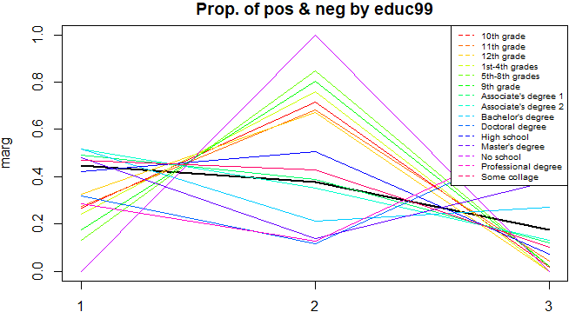
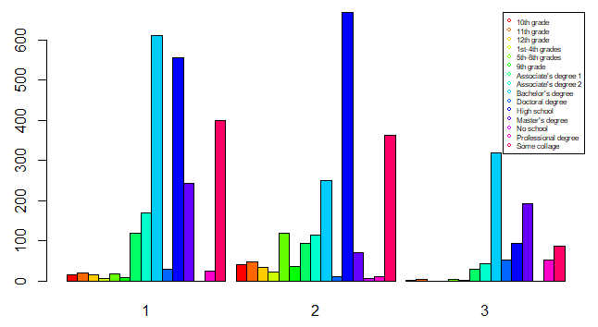
PROFILING
Educ99
Notes:
in this plot we can see the education level of the different clusters, cluster two has the highest amount of individuals who decided to finish their educations right after or before finishing high school.
cluster three has the highest percentage of individuals with a doctoral, masters, advanced or bachelor’s degree, it also has the lowest percentage of individuals that decided to finish their education right after or before finishing highschool.
cluster one has a higher level of education than cluster two, but it’s percentually lower than that of cluster three

Slide 31
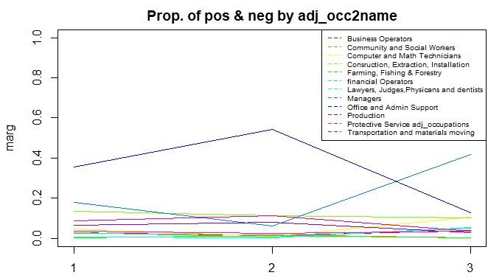
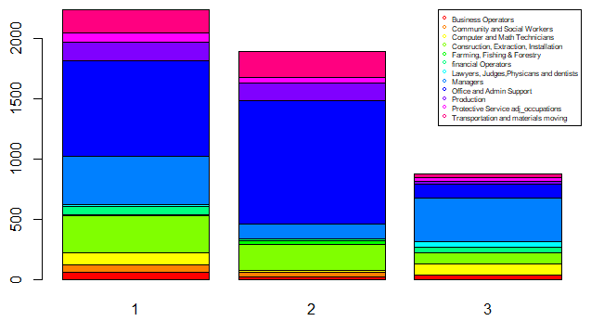
PROFILING
Occupation
Notes:
in terms of the occupations of the individuals in every cluster, cluster two has the highest percentage of office and admin support workers, with more than half their individuals having this as their occupation. cluster three has the lowest percentage of them. the most frequent occupation in cluster 3 is managers, with around 40% of them being managers.
cluster one is again, an in between cluster two and three.

Slide 32
PROFILING CONCLUSIONS
 | Incwag-e | Sex | Race | Educ99 | Occupation
Low Income Cluster (Cluster 2) | Lowest mean income | Highest % of female individuals | Highest % of non-white people | Lowest education level | High % of Office & Admin support
High Income Cluster (Cluster 3) | Highest mean income | Highest % of male individuals | Lowest % of Hispanic | Highest education level | High % of Managers
Middle Income Cluster (Cluster 1) | Average income almost equal to global inc wage | Balanced % of male and female | Race is balanced | In between cluster 1 and 2 | High % of Office & Admin support

Slide 33
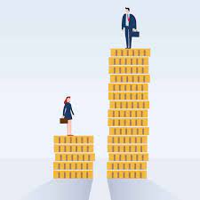
CONCLUSIONS
Main conclusion:
Pay gap exists in our dataset
What effects does some variables have to the wages?
Being white, married and with an high degree
Being male

Slide 34
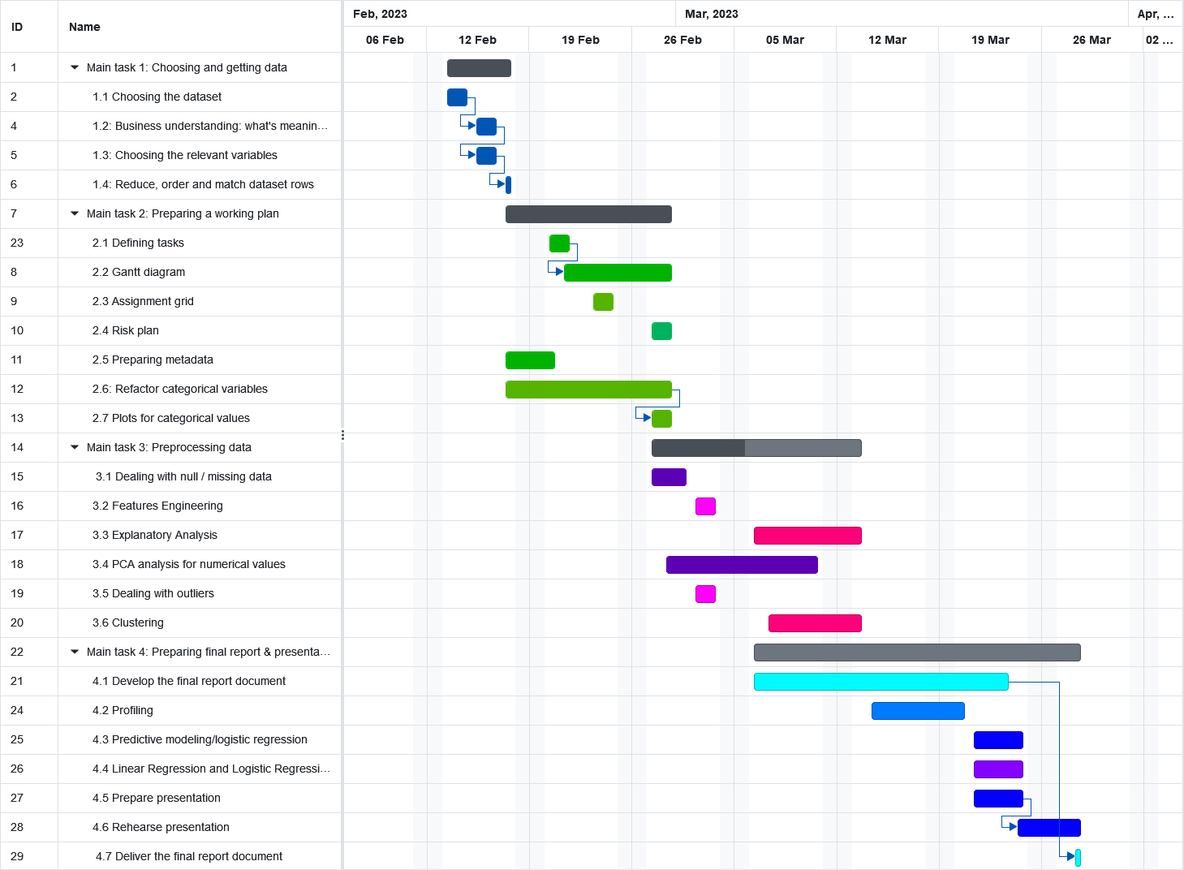
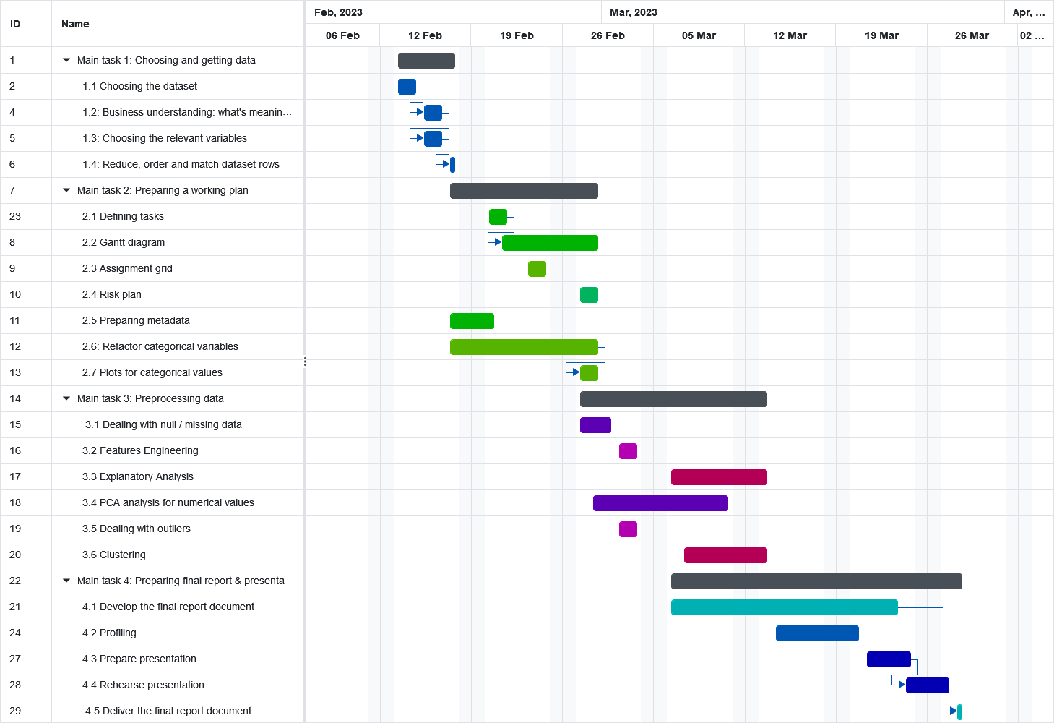
ORIGINAL AND FINAL SCHEDULING

Slide 35
THANKS FOR YOUR ATTENTION !
Alessandro Scannavini
Miguel Gutiérrez
Joan Areal
Fujie Mei
Laia Bonilla

